Slide 1
Module-8 AWS Migration and Hybrid Architecture
AWS Migration and Hybrid Architecture,
AWS Database Migration Service (DMS)
AWS Server Migration Service (SMS)
AWS Snowball
AWS Snowball Edge
AWS Snowmobile

Slide 2
AWS Migration
Migration involves moving workloads, applications, and data from on-premises environments or other cloud providers to AWS.
Given the benefits of scalability, flexibility, and managed services, AWS migration is often strategic for fast-growing businesses

Slide 3
The migration process typically follows these phases:
Assessment
Planning
Migration Options
Execution:
Optimization

Slide 4
Hybrid Architecture
A hybrid architecture combines on-premises infrastructure with AWS cloud resources, allowing businesses to operate seamlessly across environments.

Slide 5
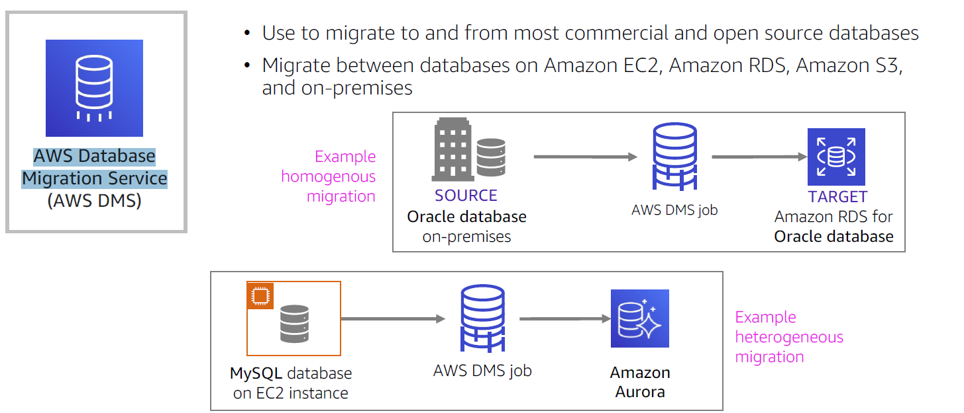
AWS Database Migration Service (DMS)

Slide 6
AWS Server Migration Service
AWS Server Migration Service (SMS) is a powerful, agentless service designed to simplify and automate the migration of on-premises servers to AWS. With AWS SMS, you can migrate virtual machines (VMs) from VMware, Microsoft Hyper-V/SCVMM, and other on-premises environments directly to AWS without needing agents on each server.

Slide 7
Key Features
Incremental Replication: AWS SMS supports incremental, scheduled replications, allowing you to migrate servers in stages. This approach reduces downtime and enables smoother migration, especially for large applications.
Agentless Migration: AWS SMS does not require installation of agents, which makes it easier to set up and avoids potential compatibility issues.
Compatibility: It works with different hypervisors like VMware, Hyper-V, and Azure VMs, making it versatile for migrating various workloads.
Automated Orchestration: AWS SMS automates the migration process with scheduling, so migrations can happen during off-peak hours with minimal disruption.
Supports Multi-Server Migration: It enables you to create a group of servers to migrate together, which is especially helpful for applications with multiple servers that need to move at once.

Slide 8
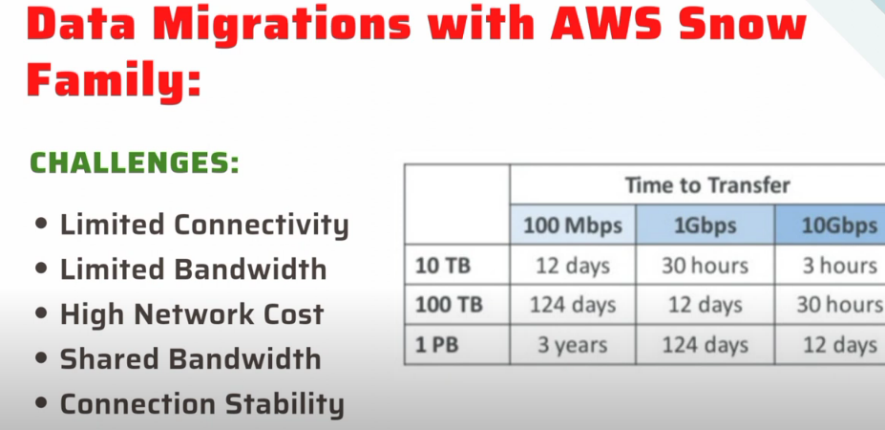

Slide 9
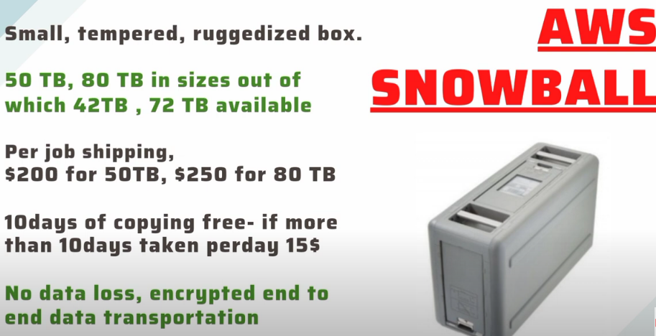

Slide 11
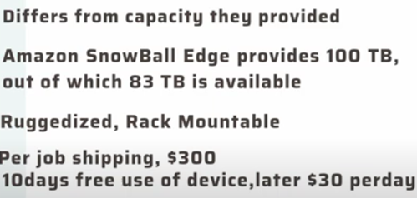
AWS Snowball Edge

Slide 12
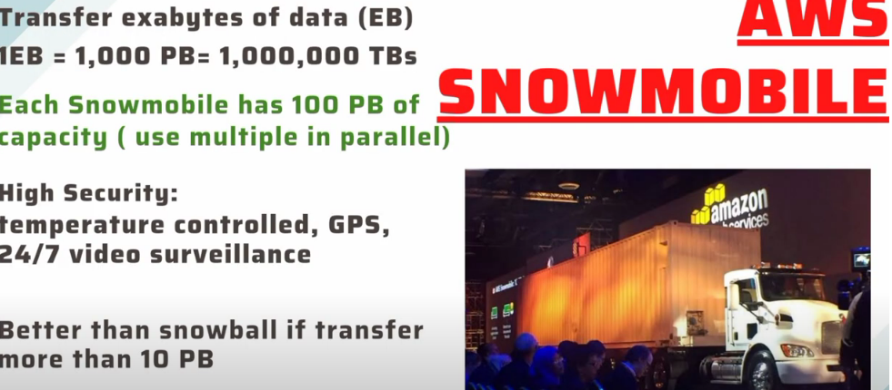
AWS Snowmobile

Slide 13
AWS Snow Family services—AWS Snowball, AWS Snowball Edge, and AWS Snowmobile—are designed to help transfer large amounts of data to and from AWS in situations where network connectivity might be slow, costly, or unreliable.

Slide 14
AWS Snowball: Moving 80 TB of archived video footage from an office to AWS for long-term storage.
AWS Snowball Edge: Collecting and analyzing sensor data on an offshore oil rig, then uploading processed data to AWS.
AWS Snowmobile: Migrating an entire 80 PB data center to AWS for cloud modernization.

